Slide 1

Thera Bank Loan Purchase Modeling
BANK
Module 4 Project
Submission by: Mohanned T. Gomaa
Date: 15 Feb 2020

Slide 2
Project Overview
Thera Bank has a growing customer base, were the majority are liability customers or depositors, while asset customers or borrowers size is quite small;
The bank is interested in expanding their borrowers base, to profit from loan interest;
In efforts to understand client needs, Management has lunched in 2019 a personal loan campaign, yielding 9.6% successful conversion rate;
For 2020, the bank Marketing team has devised a new strategy based on targeted marketing campaigns, to minimize budget spend;
The team wants assistance in building a model that will help them identify the potential customers who have a higher probability of purchasing the loan. This will increase the success ratio while at the same time reduce the cost of the campaign.
12
09
03
06

Slide 3
Customers Data Set Overview
The dataset has data on 5000 customers, covering 14 Variables as shown below;
Variables | Description
ID | Customer ID
Age | Customer's age in years
Experience | Years of professional experience
Income | Annual income of the customer ($000)
ZIPCode | Home Address ZIP code.
Family | Family size of the customer
CCAvg | Avg. spending on credit cards per month ($000)
Education | Education Level. 1: Undergrad; 2: Graduate; 3: Advanced/Professional
Mortgage | Value of house mortgage if any. ($000)
Personal Loan (Target) | Did this customer accept the personal loan offered in the last campaign?
Securities Account | Does the customer have a securities account with the bank?
CD Account | Does the customer have a certificate of deposit (CD) account with the bank?
Online | Does the customer use internet banking facilities?
CreditCard | Does the customer use a credit card issued by the bank?
12
09
03
06

Slide 4
Exploring Data
Section 1

Slide 5
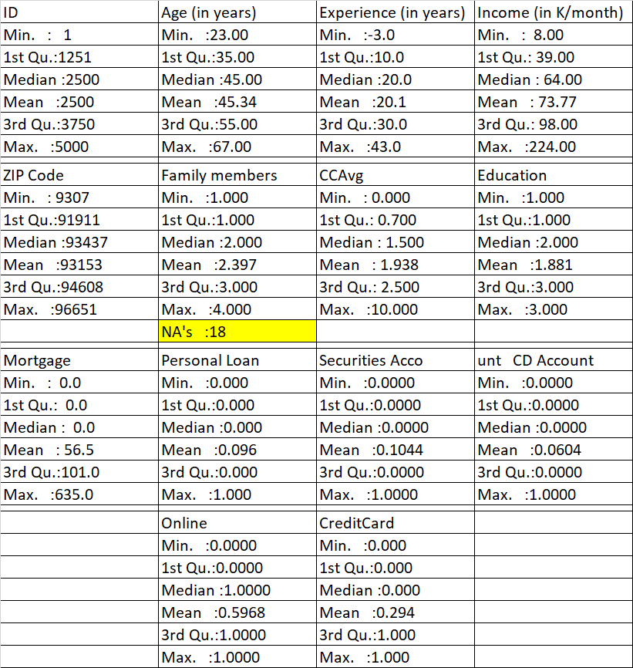
Data Summary – Basic profiling
Age profile: Ranging between 23 to 67 years. The avg. and of most common (or mode) age being ~45 years.
Experience profile: Ranging between 3 to 43 years. The avg. and of most common experience being ~20years.
Income profile: Ranging between USD 8 to 224K per annum. The an avg. income being ~USD74k.
Family size: Ranging between 1 to 4 pax. The avg. and of most common size being 2 pax.
Credit Card usage: Ranging between 0 to 10x per month. The an avg. usage and most common being ~2x per month.
Education profile: Ranging between 1 to 3years. The avg. and of most common (or mode) education in years being ~2.
House Mortgage : Ranging between USD 0 to 635K per annum. The an avg. mortgage being ~USD57k.

Slide 6
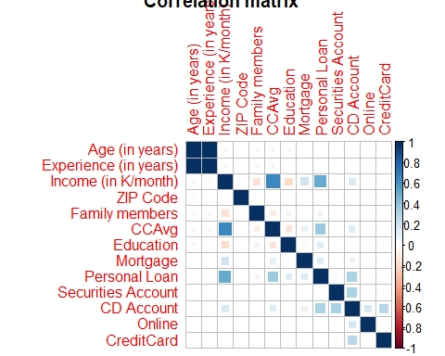
Data Summary – Understanding data relationships
Personal Loans (Target) has shown a strong positive relation with below variables, as shown in plot to the right;
Annual Income
Credit card usage per month
Having a certificate of deposits
And less so with;
Education level
Mortgage
Note that variables are listed in Descending order, based on their correlation strength with personal loans.
Correlation Matrix

Slide 7
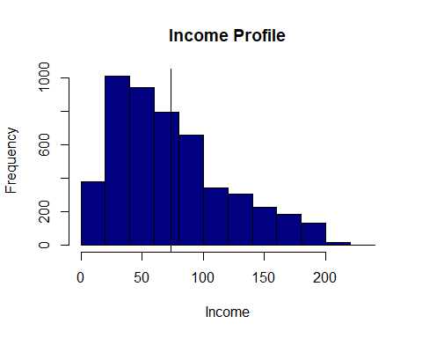
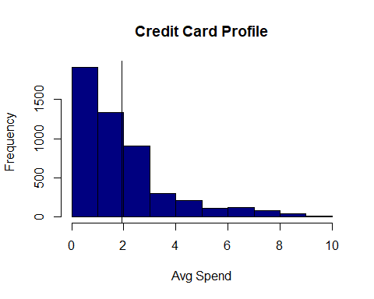
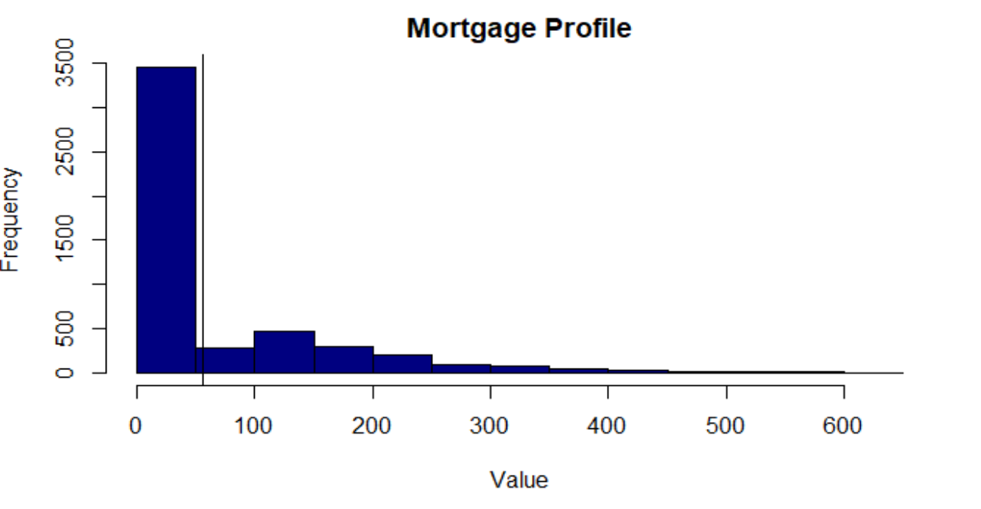
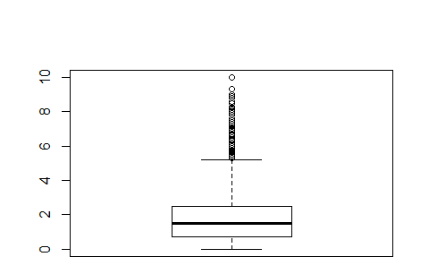
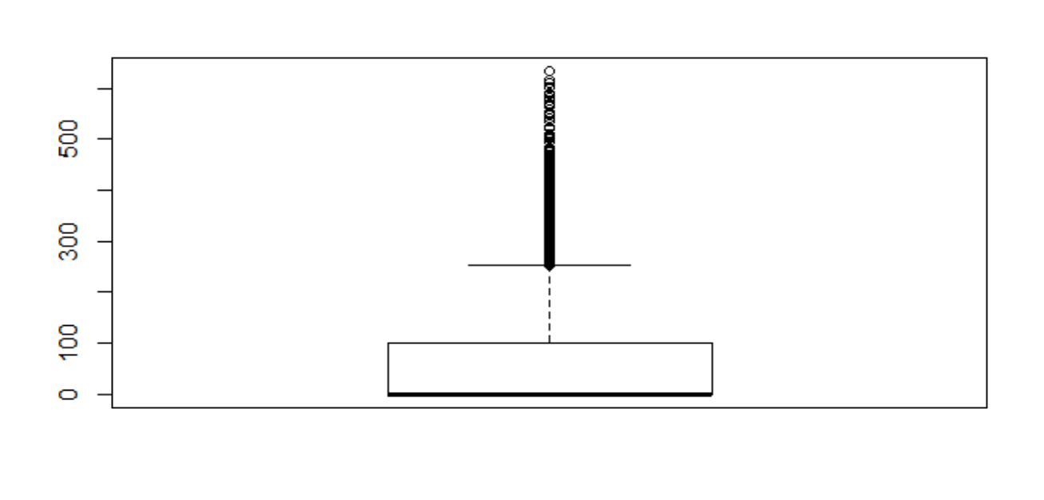
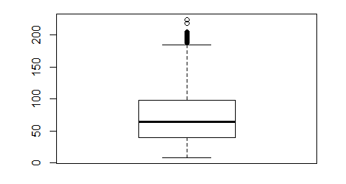
Data Summary – Understanding my variables
The income profile is skewed to right, with some visible outliers. Meaning that most of customer base are in lower earning brackets between 25-100k
Credit profile is also skewed to right, with highly visible outliers. Meaning that most of customer base are low spenders between 0-3k
Nearly 3500 clients has a mortgage below USD50k. Higher mortgage value are not very common.

Slide 8
Client Base Clustering
Section 2

Slide 9

Clustering – Client profile
As an outcome of our clustering technique we were able to cluster our clients into two main cluster;
Non- Loan Takers
Income USD57k
CCAvg USD1k a month
Mortgage USD44k
Loan Takers
Income USD145k
CCAvg USD4k a month
Mortgage USD109k

Slide 10
Classification Model…
Section 3

Slide 11
Classification Model – Approach
Deploy two model
Two classification models were selected ;
1- CART; &
2- Random Forest.
Select a Model
Random Forest was selected as it preformed better than its adversary.
Data Preparation
Basic data preparation including;
1- Removing unnecessary variables;
2- Missing Value treatment;
3- Splitting data into train and test.
Test model performance
Number of model performance test were used;
1- Confusion Matrix;
2- ROC, AUC and Gini;
3- Rank order Tables Ks; &
4- Concordance ratios.

Slide 12
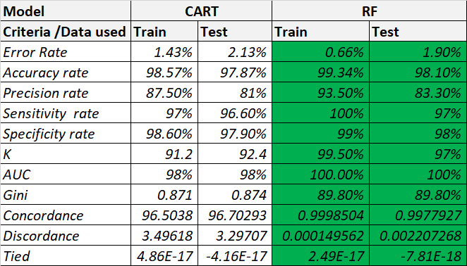
Classification Model – Model Selection Criteria
Based on the number of model performance, Random forest has preformed better across all categories test.
Consequently we recommend using RF for predications.

Slide 13
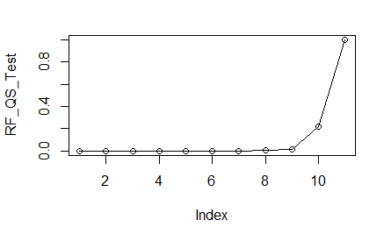
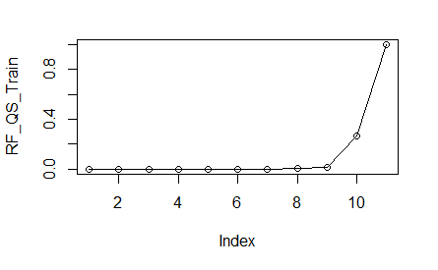
Random Forest – Key take Away
Based on the random forest outcome, we recommend that you target the 10th and 11th quantile of customers, as top ten of all probabilities of accepting our loan offer are located.
If we do this will ensure successful conversion rate, nearly 100%.

Slide 14
Appendix: Classification Model…
Section 4

Slide 15
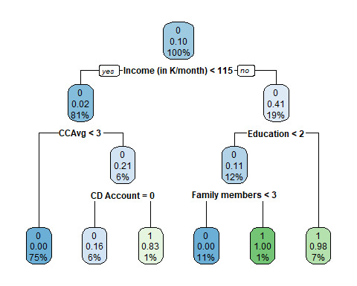
CART – Key take Away
Based on the CART model here is the criteria for accepting our loan offer
Income More than USD115k
CCAVG more than USD3k
Yes CD Account
Alternatively
Income Less than USD115k
Education more than 2 years or
Education less than 2 years with family greater than 3pax.

Slide 16

Notes:
You can safely remove this slide. This slide design was provided by SlideModel.com – You can download more templates, shapes and elements for PowerPoint from http://slidemodel.com

